Slide 1
WAVES IN PORTUGAL vs HURRICANES IN THE ATLANTIC
FILIPA LOPES
Project 4 for Data Analytics
13th September 2019

Slide 2
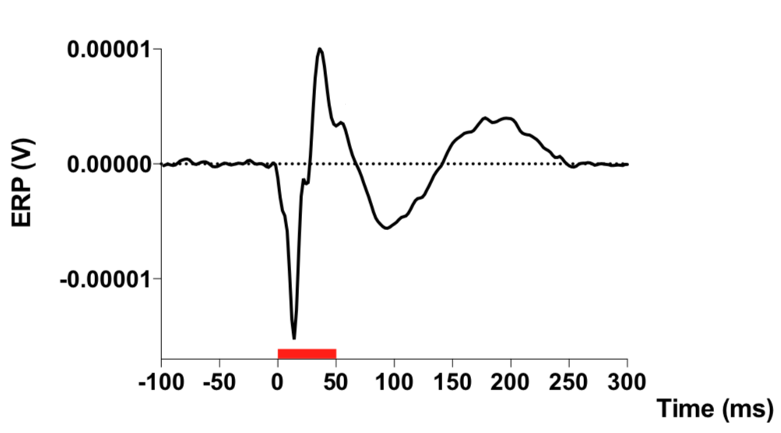
Notes:
The left one was obtained using 5 different programs. Right one just with python.

Slide 3
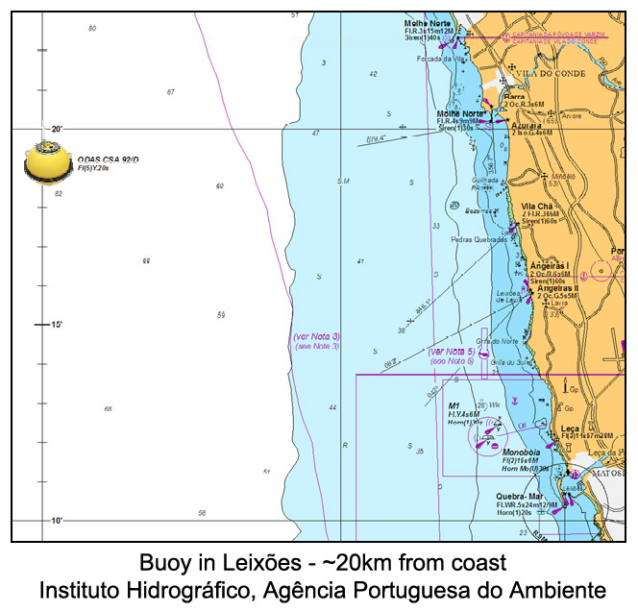
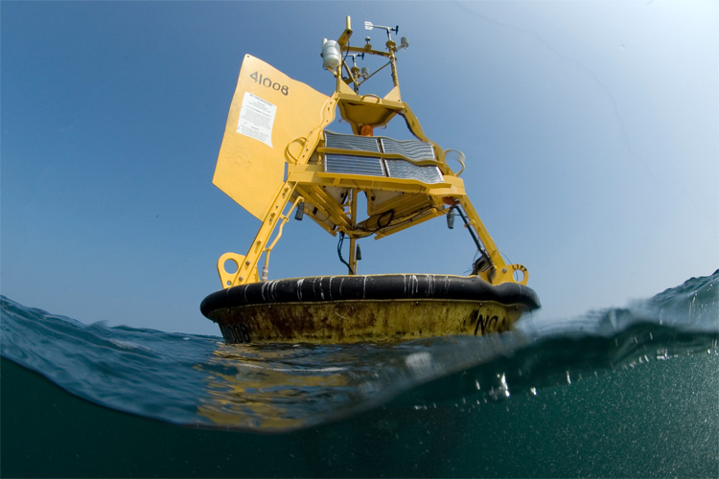
Waves measuring buoy data Portugal 1995-2014

Slide 4
Wave measures Portugal
No data
Source of data: Instituto Hidrográfico, Agência Portuguesa do Ambiente
Notes:
What is creating these waves? What is the stimulus?

Slide 5
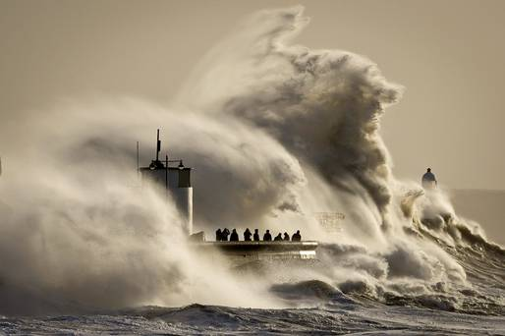
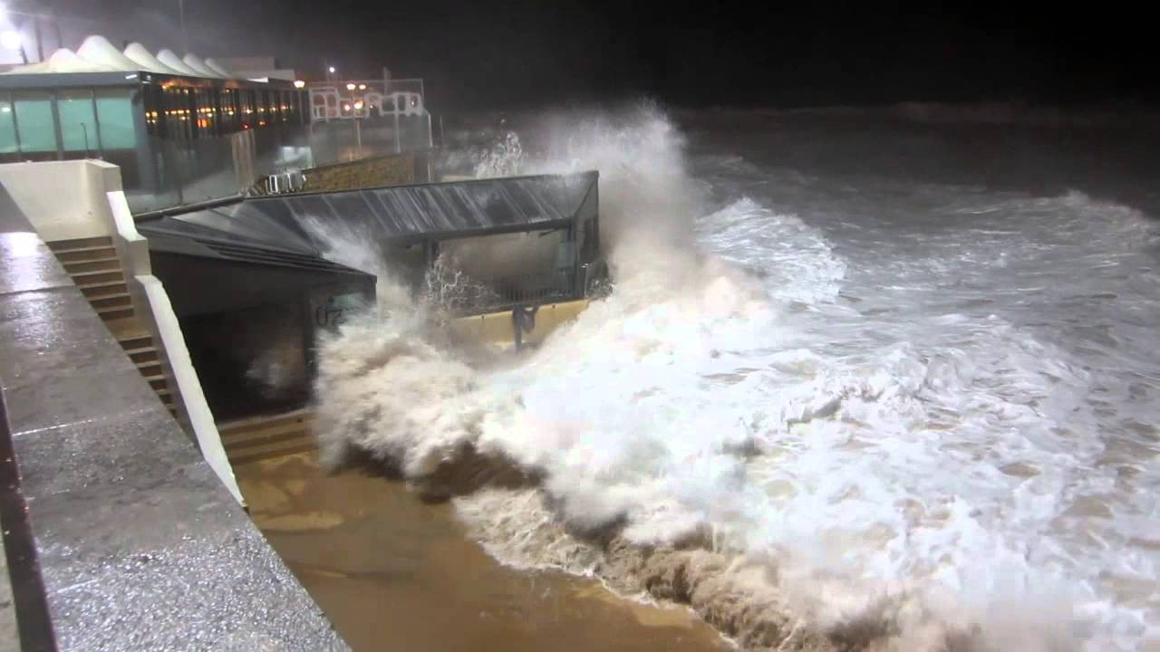
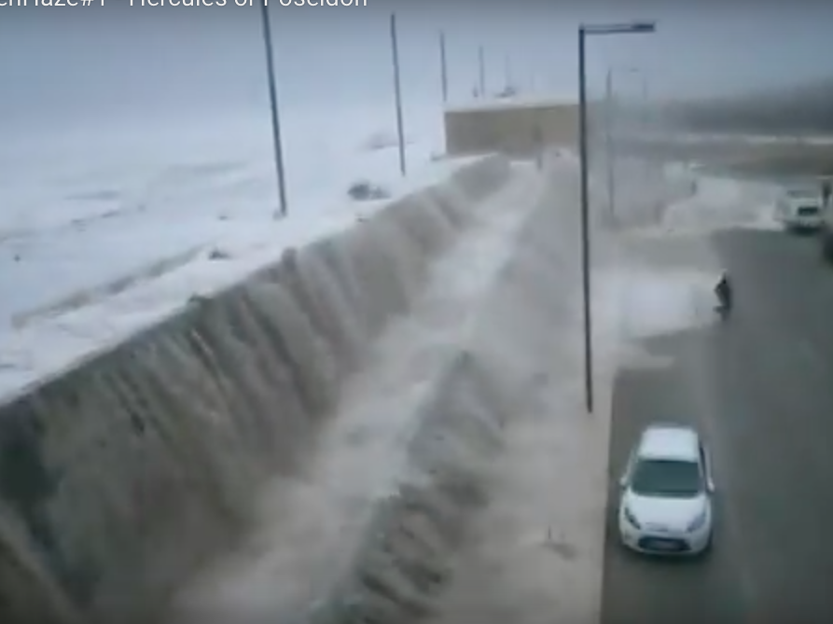
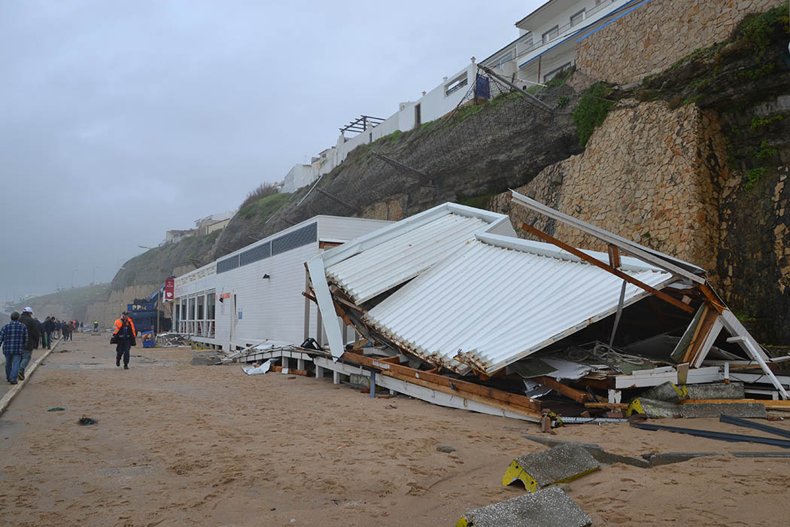
Hercules Storm
3th – 7th January 2014
Portugal
Notes:
Red alert 7 districts
Roads closed, restaurants destroyed, millions in reconstruction, …
Another day in ocean live but significant impact for us.

Slide 6
Wave measures Portugal January 2014

Slide 7
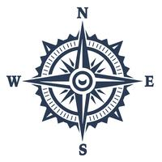
wave direction

Slide 8
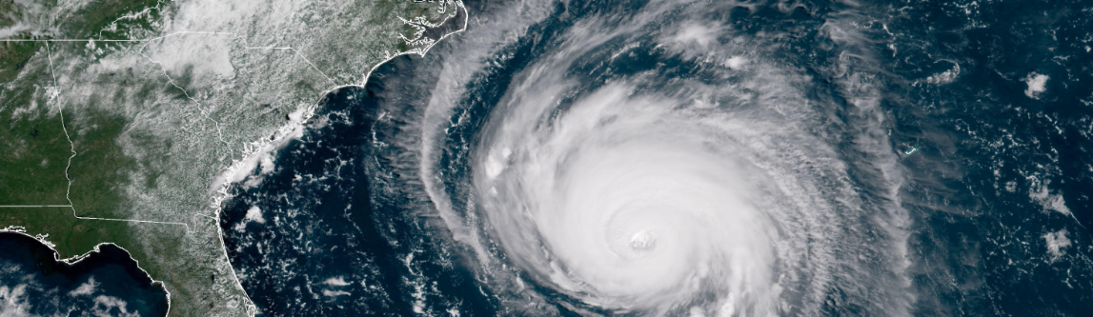
Hurricanes and Typhoons Atlantic, 1851-2015
Source: Kaggle / National Hurricane Center
Notes:
50K hurricanes

Slide 9
Wave measures Portugal 2007
Source of data: Instituto Hidrográfico, Agência Portuguesa do Ambiente
Notes:
Some nice Portuguese waves, with a nice spectrum of variation
Let’s see what was happening in the Atlantic on these dates…

Slide 10
Waves → Portugal
Hurricanes →
Atlantic
Notes:
There were too many variables (wind, direction, pressure, origin of hurricane) to correlate with the wave height.

Slide 11
Thank you! Questions?
Notes:
Challenges:
Portuguese data: where are you?
Just a lot of data…

Slide 12
Waves → Portugal
Hurricanes →
Atlantic

Slide 13
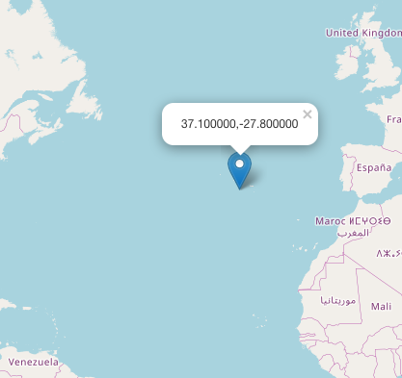
Hurricane 7th Dec 2013 ?
Hercules storm in Portugal – cause?
GPS Coordinates (Lat | Long)
37° 6' 0’’ N | 27° 48' 0'' W

